Slide 1
Balance of Payments
Asma Khalid
Senior Economist
State Bank of Pakistan

Slide 2
Factors Affecting External Position
“BOP is a statistical statement that summarizes
transactions between residents and non- residents during a period” and consists of :
Goods and services account
Primary income account
Secondary income account
Capital account, &
Financial account

Slide 3
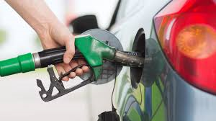
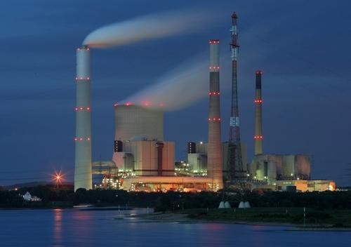
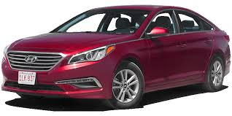
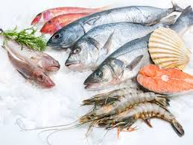
Goods Account

Slide 4
Import of Goods
 | FY17 | FY18
Food | 6143 | 6184
Palm oil | 1,905.1 | 2,039.7
Pulses | 952.4 | 534.9
Machinery | 11755 | 11562
Transport | 3327 | 4388
Petroleum | 9385 | 11706
Textiles | 3358 | 3664
Agri | 7583 | 8918
Metal | 4412 | 5357
Misc. | 1223 | 1294
Total | 52,910 | 60,795

Slide 5
Import of Goods

Slide 6
Import of Goods

Slide 7
Export of Goods
 | FY17 | FY18
Rice | 1,606.8 | 2,035.7
Sugar | 161.0 | 474.9
Yarn & fabrics | 3,380.2 | 3,575.5
Garments | 4,680.3 | 5,288.4
Bedwear | 2,137.7 | 2,261.1
Leather | 837.0 | 853.1
POL | 189.3 | 393.6
Others | 5,176.1 | 5,933.6
Total Exports | 20,421.7 | 23,212.0

Slide 8
Export of Goods

Slide 9
Export Challenge
Notes:
Increasing exports now appear to be a humungous task. Our exports are stuck in low value added products with heavy concentration in fewer items and fewer markets. Without a deliberate push, it is not possible to upgrade Pakistan’s production and export structures. What we need is a well co-ordinated industrial policy, with an explicit focus on exports. Strategy should not be on giving sector-specific monetary incentives, but towards a broader institutional support to exporters.

Slide 10
Trade Deficit

Slide 11
Trade Deficit in Perspective

Slide 12
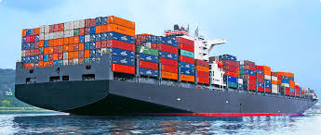
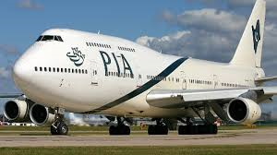
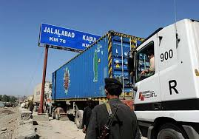
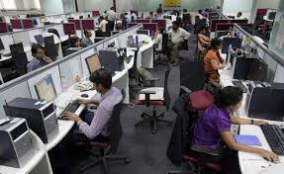
Services Account

Slide 13
Major Services
Deficit(-)/surplus(+) in Major Services | FY17 | FY18
Transport | -2,954 | -3,012
Travel | -1,678 | -1,742
Construction | 47 | 16
Insurance and Pension Services | -182 | -177
Financial Services | -152 | -161
Charges for the use of Intellectual Property | -210 | -218
Telecommunications, Computer, and Info Services | 556 | 586
Other Business Services | -831 | -1,569
Government Goods and Services n.i.e. | 1,119 | 627

Slide 14
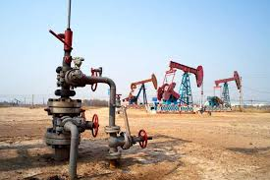
Primary Income

Slide 15
Classification of Primary Income
Compensation of Employees
Investment Income
Direct Investment Income
On equity
On debt
Portfolio Investment Income
On equity
On debt
Other Investment Income
Other Primary Income

Slide 16
Classification of Primary Income
Sector | FY17^{(R)} |  |  | FY18 ^{(P)}
 | Payments on |  |  | Payments on
 | FDI | FPI | Total FI | FDI | FPI | Total FI
Total | 1,735.5 | 374.4 | 2,109.9 | 2,008.8 | 311.5 | 2,320.3
Communications | 180.0 | 0.8 | 180.8 | 329.3 | 0.7 | 329.9
Telecommunications | 177.2 | 0.6 | 177.8 | 327.2 | 0.6 | 327.8
Financial Business | 262.4 | 128.8 | 391.2 | 230.5 | 84.0 | 314.4
Oil & Gas Explorations | 119.3 | 20.7 | 139.9 | 230.5 | 29.1 | 259.6
Power | 151.9 | 14.0 | 166.0 | 228.6 | 12.2 | 240.8
Thermal | 151.9 | 14.0 | 166.0 | 218.7 | 12.2 | 230.8
Food | 265.9 | 5.5 | 271.3 | 211.1 | 4.0 | 215.1
Chemicals | 95.2 | 45.2 | 140.4 | 120.9 | 15.5 | 136.4
Transport Equip (Auto) | 61.5 | 54.8 | 116.3 | 103.1 | 20.5 | 123.6
Cars | 29.6 | 53.9 | 83.6 | 65.8 | 18.6 | 84.4
Transport | 63.6 | 2.0 | 65.6 | 85.8 | 2.0 | 87.9

Slide 17
Secondary Income

Slide 18
Classification of Secondary Income
Workers' Remittances by Source
 | Value (million US dollar) |  |  |  | YoY growth (%)
 | FY16 | FY17 | FY18 |  | FY17 | FY18
GCC | 12,756 | 12,123 | 11,351 |  | -5.0 | -6.4
KSA | 5,968 | 5,470 | 4,859 |  | -8.4 | -11.2
UAE | 4,365 | 4,328 | 4,333 |  | -0.9 | 0.1
Kuwait | 774 | 764 | 774 |  | -1.3 | 1.4
Oman | 819 | 761 | 657 |  | -7.1 | -13.6
Bahrain | 448 | 396 | 356 |  | -11.6 | -10.3
Qatar | 381 | 404 | 371 |  | 6.2 | -8.2
USA | 2,525 | 2,453 | 2,714 |  | -2.8 | 10.6
UK | 2,580 | 2,342 | 2,763 |  | -9.2 | 18.0
EU | 418 | 483 | 656 |  | 15.5 | 35.9
Others | 1,638 | 1,951 | 2,140 |  | 19.1 | 9.7
Total | 19,917 | 19,351 | 19,623 |  | -2.8 | 1.4
Data source: State Bank of Pakistan

Slide 19
Classification of Secondary Income

Slide 20
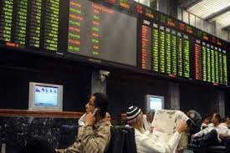
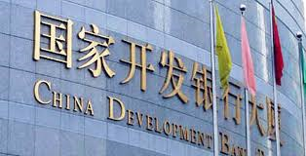
Financial Account

Slide 21
Classification of Financial Account
Net acquisition of financial assets /Net
incurrence of liabilities
Direct Investment
Portfolio Investment
Financial derivatives
Other Investment &
Reserve Assets

Slide 22
Classification of Financial Account
Type on Instrument:
Equity
Debt Instruments
Institutional Sector:
Central Bank
General Government
Deposit-taking corporations
Other sectors
Maturity
Short-term
Long-term

Slide 23
Financial Inflows

Slide 24
Aggregate Position

Slide 25
Items | Jul-Jun | Jul-Jun^{AR} | Jul-Sep
 | FY17 | FY18 | FY19^{P} | FY18
CURRENT ACCOUNT | -12,621 | -18,989 | -3,665 | -3,761
Balance on Trade in Goods | -26,680 | -31,178 | -7,872 | -7,314
Balance on Trade in Services | -4,339 | -5,719 | -938 | -1,276
Balance on Primary Income | -5,048 | -5,487 | -1,079 | -1,057
Workers' Remittances | 19,351 | 19,623 | 5,420 | 4,790
Balance on Secondary Income | 23,446 | 23,395 | 6,224 | 5,886
CAPITAL ACCOUNT | 375 | 391 | 100 | 107
FINANCIAL ACCOUNT | -10,198 | -13,337 | -2,238 | -1,870
Direct Investment | -2,663 | -3,082 | -438 | -763
Portfolio Investment | 250 | -2,258 | 133 | 98
Other Investment | -7,785 | -7,997 | -1,933 | -1,205
Net Acquisition of Financial Assets | 1,180 | 209 | -248 | -388
Net Incurrence of Liabilities | 8,965 | 8,206 | 1,685 | 817
Overall Balance | 1,946 | 6,118 | 820 | 2,147

Slide 26
FX Reserves

Slide 27
Factors Affecting External Position
Balance of payments
Domestic demand (macro policies; informal economy; remittances)
Investment climate (Security; stability; energy; doing business; perception/country image)
Competitiveness (productivity; currency valuation; marketing; supply chain; quality)
External demand
(Global policies; sentiments)
Commodity prices

Slide 28
Factors Affecting External Position
Income level (real)
Fiscal Policy
Monetary Policy
Exchange rate
Trade measures
Domestic demand
Import of goods and services

Slide 29
Policy Measures
SBP has raised the policy rate by a cumulative 275 bps since Jan-18
The rates on subsidized loan schemes for export-oriented industries are kept unchanged
The government has announced cut back in development spending
Austerity measures are also underway
Exchange rate adjustment (21.1% from Dec-18 to 10th Oct-18)
Targeted measures to cut imports:
L/C margins and regulatory duties on non-essential items;
Withdrawal of advance payment facility to importers
Payment scope for imports based on open-account narrowed
Increase in price of natural gas
Exemption given to export-oriented industries

Slide 30
Exports have Bounced Back!

Slide 31
Structural Challenges Persist
Chronic fiscal imbalances:
Pakistan has one of the lowest tax-to-GDP ratios in the world, primarily due to a very narrow tax base
Investment to GDP ratio is quite low
Pakistan lags behind other EMs in terms of ease and cost of doing business
Government borrowings from the banking system leave little liquidity for the banks to lend to the private sector
Culture of low savings in Pakistan is another challenge in promoting investment activities in the country
Export orientation of the economy remains weak
FX earnings are insufficient to finance growth-oriented imports
Recurring BoP crisis do not allow the economy to sustain growth spurts

